Slide 1
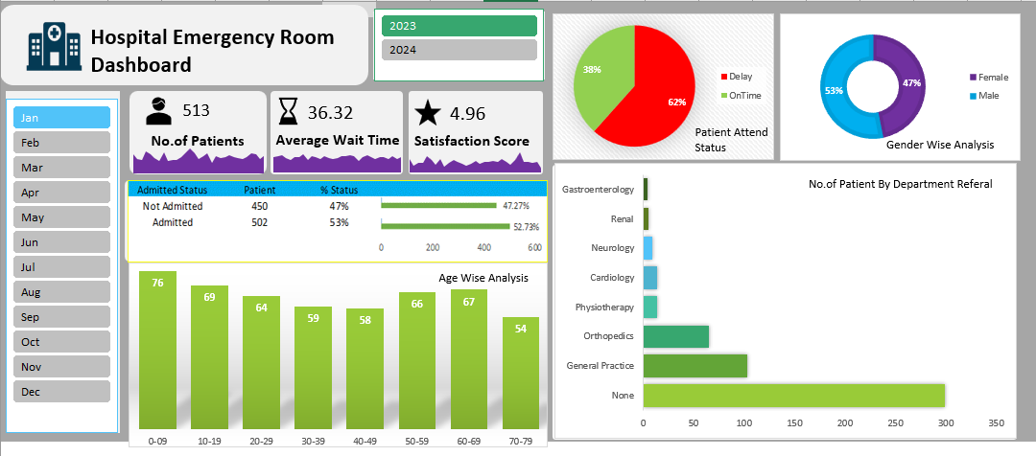
Excel Project
Project Title:Hospital Emergency Room Dashboard
Dashboard:

Slide 2
📊 Dashboard Overview:
This dashboard analyzes emergency room data for the hospital. It shows how many patient visited the ER, how long they waited, and how satisfied they were with the services. The dashboard also displays whether patients were treated on time or experienced delays and how many were admitted or discharged. In addition, it presents patient details such as age group, gender, and department referrals. Overall, it helps the hospital track performance, manage patient flow, and improve the quality of emergency care.

Slide 3
Objectives
The objective of this analysis is to evaluate the performance of the hospital emergency department by analyzing patient inflow, gender distribution, and department-wise referrals using the dashboard.
The analysis aims to improve emergency room efficiency, optimize staff and resource allocation, reduce patient waiting time, and support timely decision-making to enhance the overall quality of emergency patient care.

Slide 4
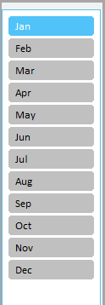
Analysis:
This is the Month wise Slicer which is used to filter the
data by month, as shown in the image. This Slicer allows easy selection of the month from January to December and instantly updates all the charts and KPIs in the Dashboard.
Suggestion:
This Slicer can be used to identify peak and low patient
month, helping the hospital plan staff and resources more
effectively. Adding a Year wise Slicer will highlight the peak
months and can further improve their decision-making.

Slide 5

The dashboard uses Pivot Tables to summarize data by applying Distinct Count to calculate the number of unique patients and the Average function to find the average wait time and satisfaction score. These values are shown using KPI charts, which help users quickly understand overall performance at a glance. As a suggestion, adding filters and performance targets, along with color indicators, would make the dashboard more interactive and easier to evaluate.

Slide 6

This part of the dashboard uses a Pivot Table to analyze patient admission status. The Pivot Table applies the % of Grand Total function to calculate the percentage of admitted and not admitted patients out of the total patient count.The results are displayed using a bar chart, which provides a quick visual comparison between admitted and not admitted patients, making it easy to identify which category has a higher share.

Slide 7
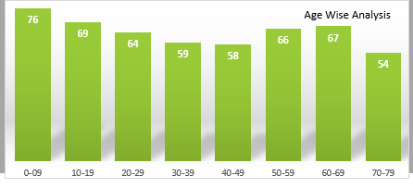
This dashboard uses a Column Chart for Age-Wise Analysis to compare patient counts across different age groups. It helps identify which age groups have higher or lower numbers of patients, making age-based trends easy to understand. As a suggestion, adding filters (such as gender or department) and percentage labels or trend comparisons would make the analysis more detailed and useful for decision-making.

Slide 8
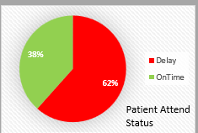
This dashboard uses a Pie Chart to represent Patient Attendance Status. The pie chart is used to show the proportion of patients who attended on time versus those who were delayed, making it easy to understand the overall attendance distribution. As a suggestion, the dashboard can be improved by adding time-based trends or target benchmarks and using color indicators with legends to quickly highlight areas that need improvement.

Slide 9
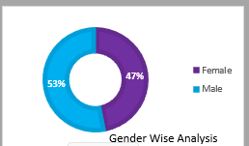
The doughnut chart is used to represent the gender-wise distribution of patients in percentage form. It clearly shows the proportion of male and female patients visiting the emergency room, helping hospital administrators quickly understand patient demographics at a glance. This insight supports better resource allocation, and availability of gender-specific facilities. As a suggestion, this chart can be made more effective by adding time-based or age-group filters text

Slide 10
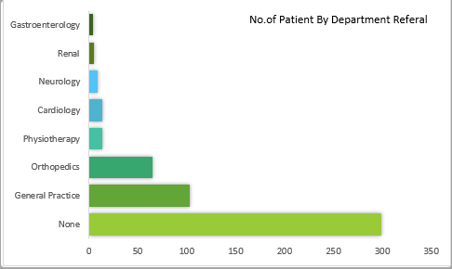
The horizontal bar chart is used in the hospital dashboard to display the number of patients referred to each department from the emergency room. It helps identify which departments receive the highest and lowest referrals, making it easy for hospital management to understand patient flow and referral patterns. . As a suggestion, adding time-based filters that can help analyze trends and improve departmental efficiency and emergency response planning.

Slide 11
Conclusion
The hospital emergency dashboard serves as a powerful data analysis tool that transforms raw emergency room data into meaningful insights. By clearly highlighting patient demographics, referral patterns, and workload distribution across departments, it enables hospital administrators to monitor performance in real time and identify pressure points in emergency services. This dashboard supports informed decision-making, optimal staff and resource allocation, reduced waiting times, and improved patient outcomes.
Overall, it enhances operational efficiency, strengthens emergency response planning, and contributes to delivering timely, high-quality patient care.

